Slide 1


My Car App
Conclusion
Introduction
Features
Flow Diagram
Data Dictionary
Team Mentor :-
Amit Degadwala
Team Members :-Chandni Chandwani
Darshit Rawal
Rutvik Rupapara
Saloni Jain
Saurabh Singh

Slide 2



Conclusion
Introduction
Features
Flow Diagram
Data Dictionary
We have created an application having a functionality to register new user and can have search the vehicle based on criteria. User can choose various option to take car on rent / purchase the vehicles. Once user choose the vehicle, user has to do payment and generate invoice.

Slide 3
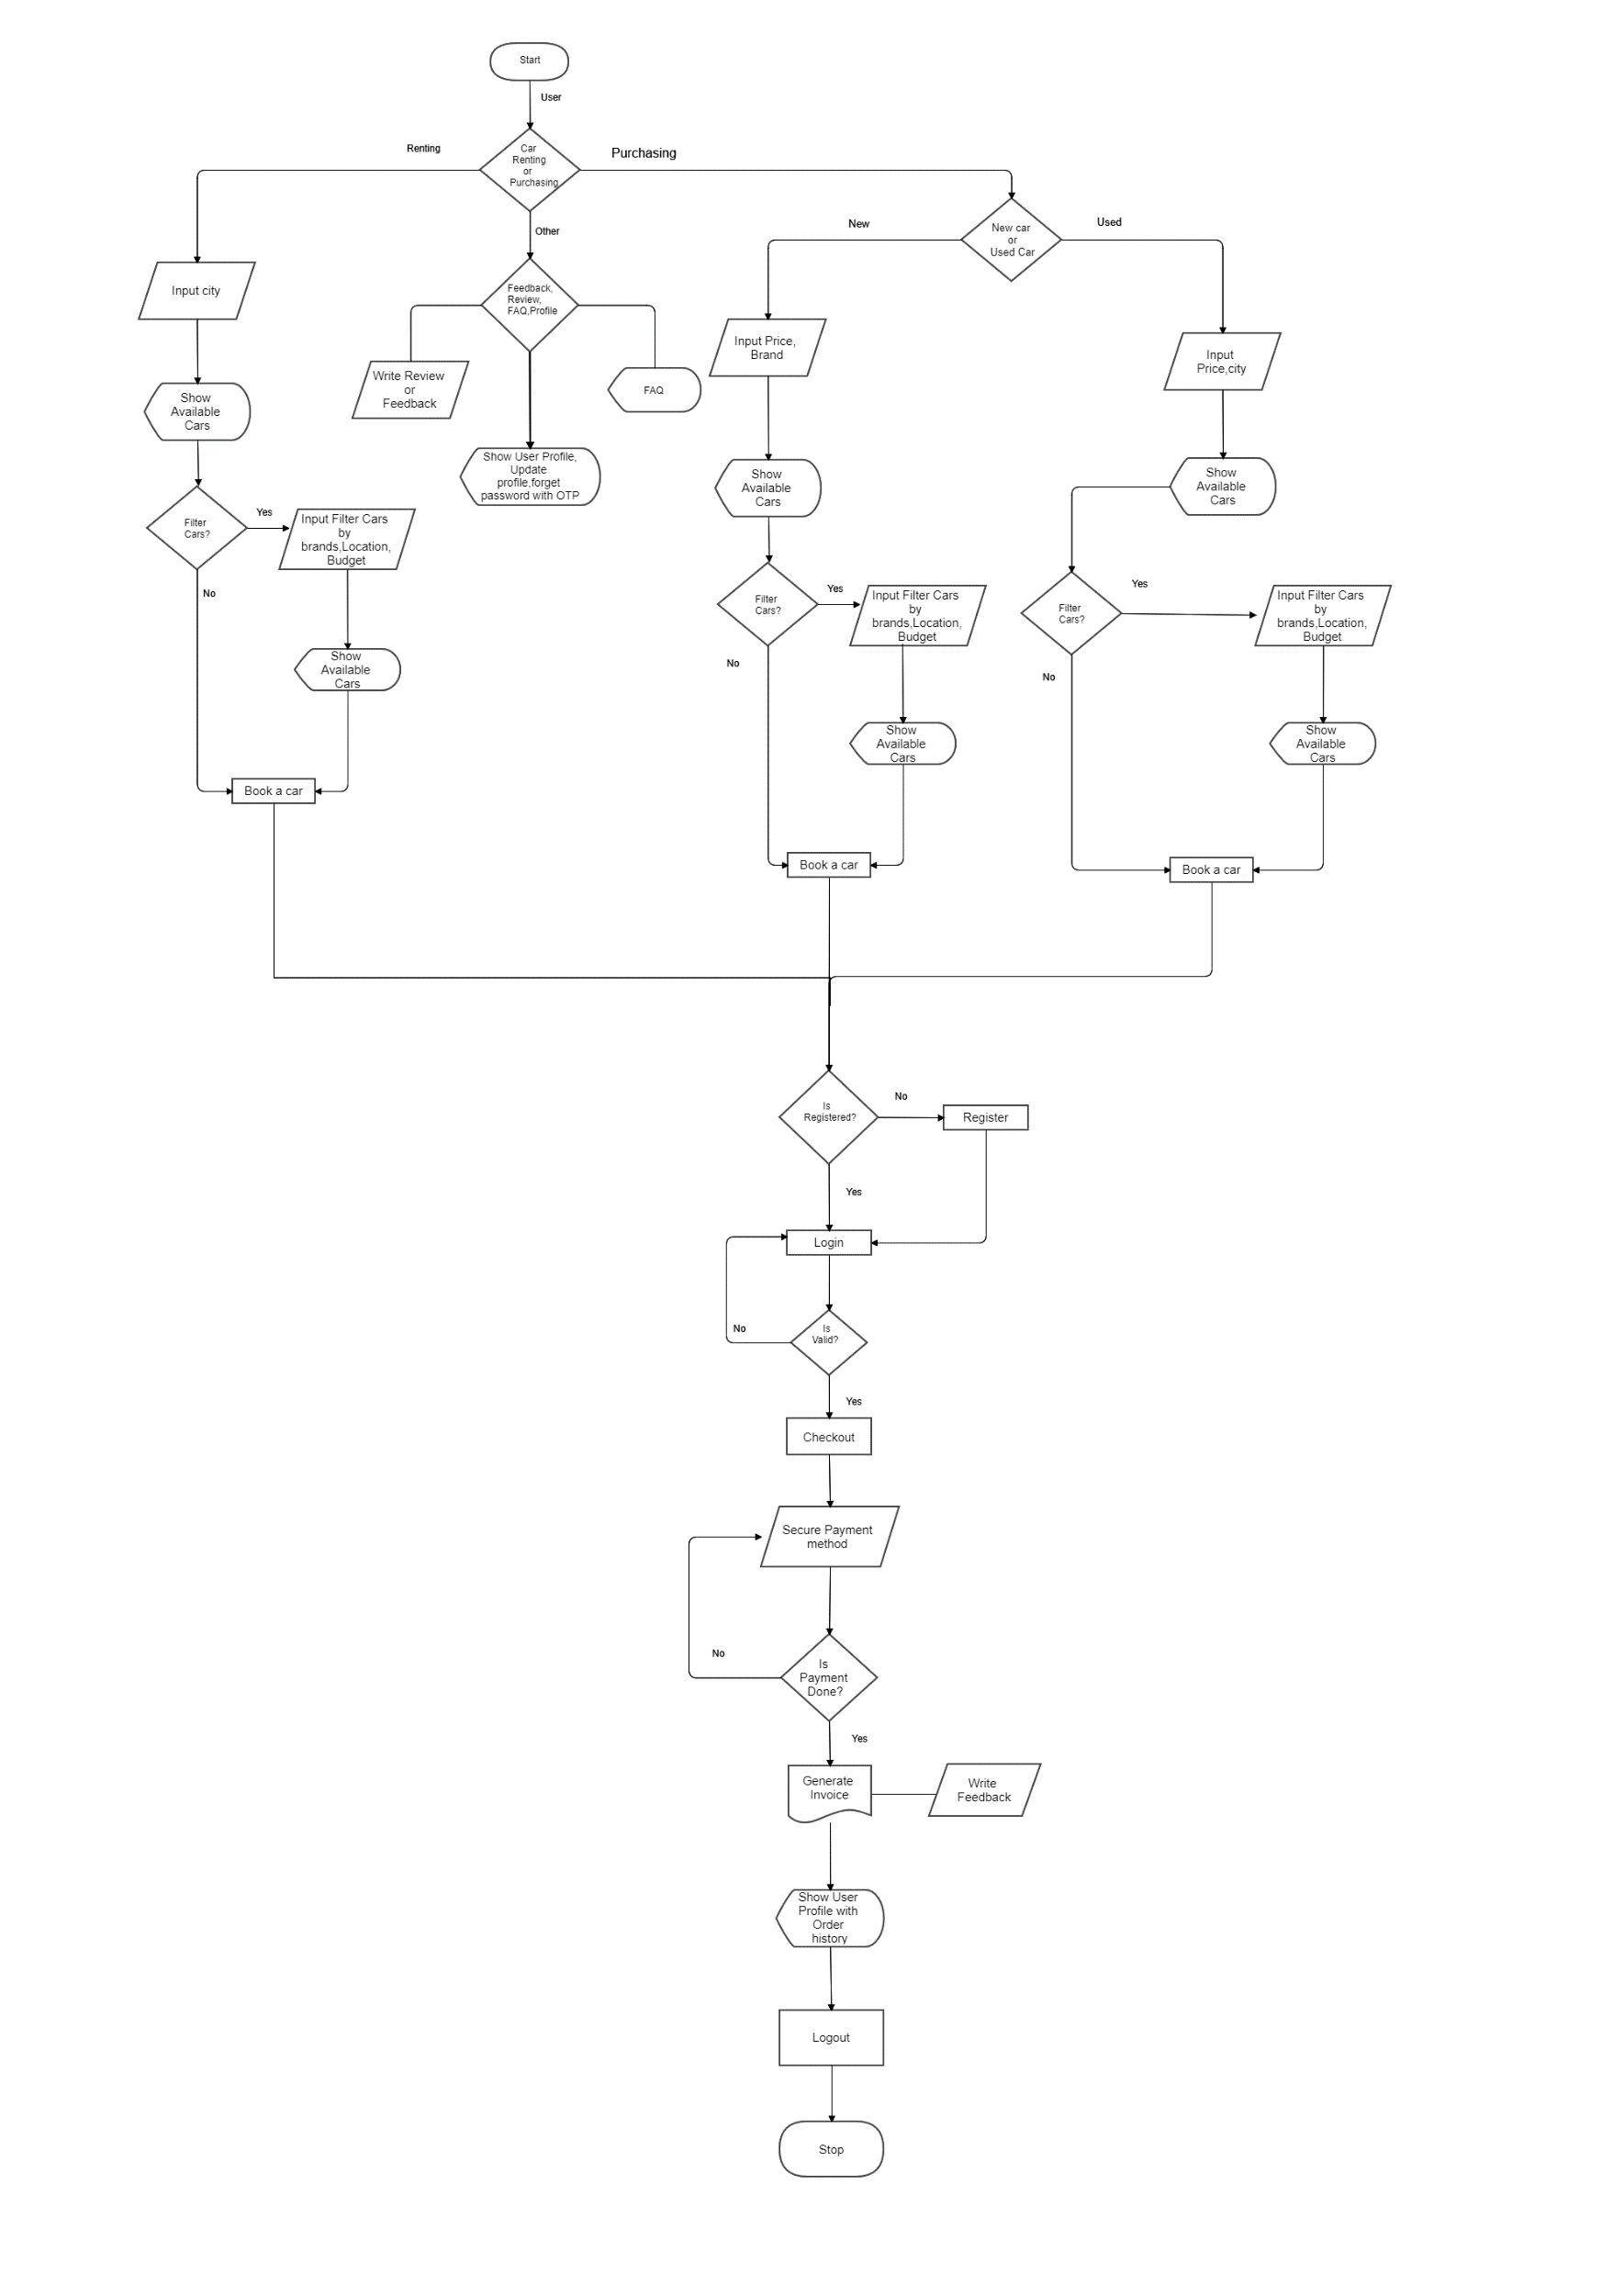
.
Data Dictionary
Features
Introduction
Conclusion
Flow Diagram

Slide 4
01
Users
06
Admin
02
Cars
07
ContactUs
03
08
Feedback
CarVarients
Features
Introduction
Conclusion
Flow Diagram
Data Dictionary
04
09
FAQs
CarPurchases
05
CarRent
10
Dealers
And other lookup tables

Slide 5
1.Purchase Car
7. Top 10 Cars
2. Rent Car
8. Latest Cars
3. Invoice Generation
9. Custom Search
Features
Introduction
Conclusion
Flow Diagram
Data Dictionary
4. API Authentication
10. Order History
5. Secured Password (Hashing and salting)
11. User Profile
6. Secure Payment
12.OTP Configuration
Data Export,Reports and much more

Slide 6
Screenshots

Slide 7
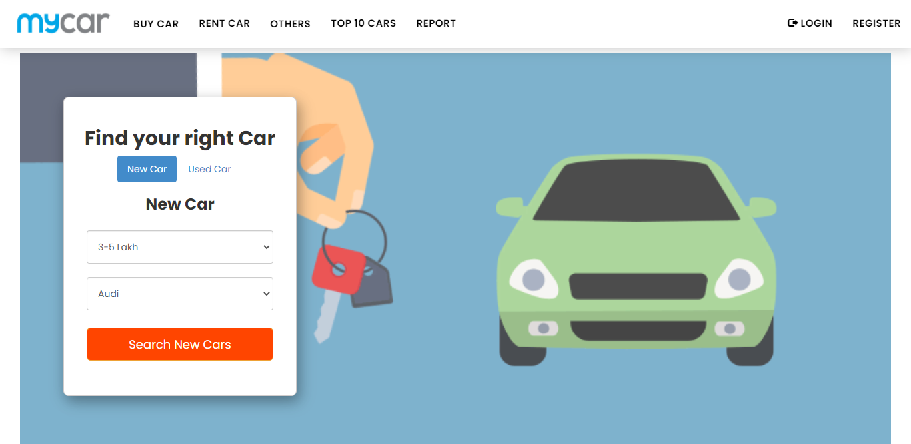
Home Page

Slide 8
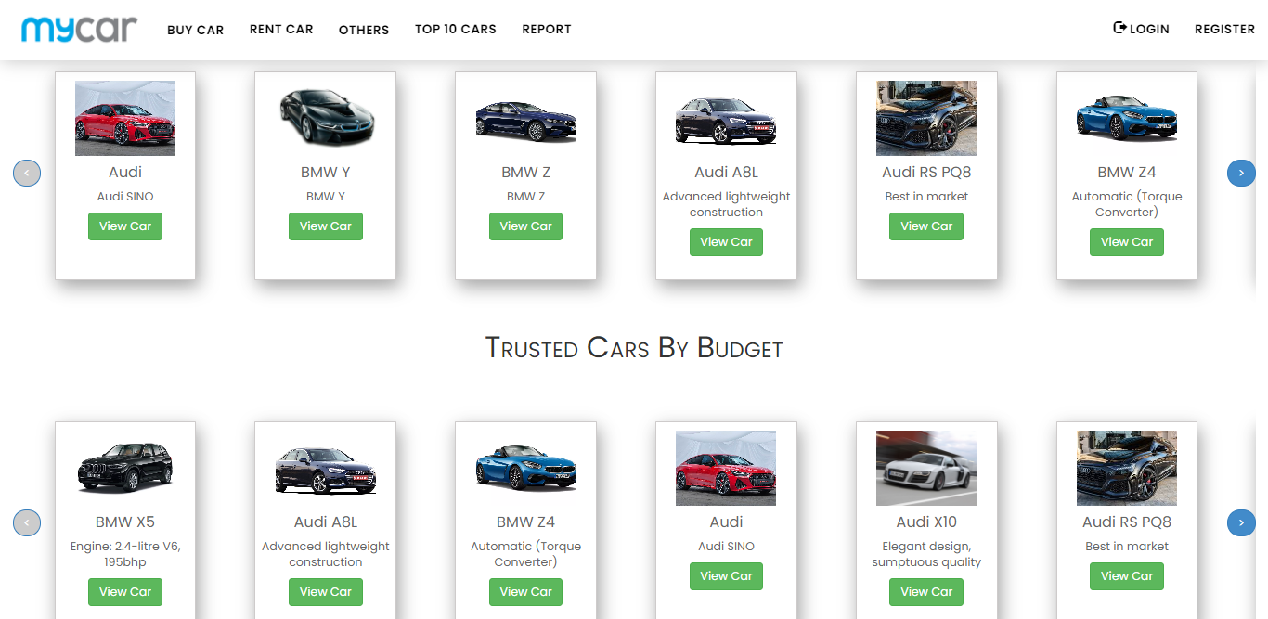
Home Page with Latest Cars and budget friendly Cars

Slide 9
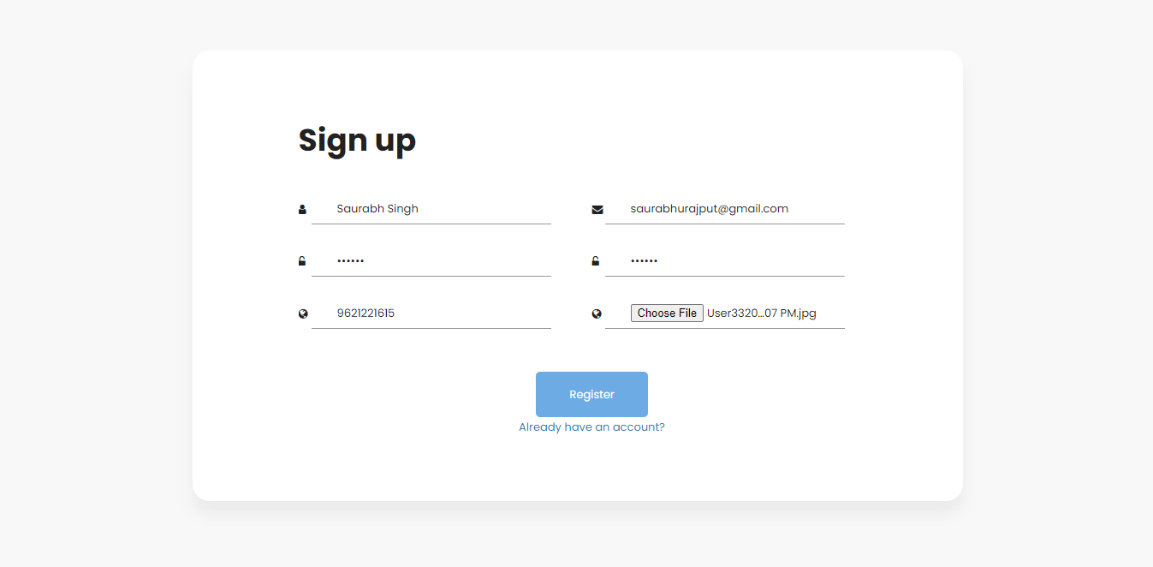
Sign up Page

Slide 10
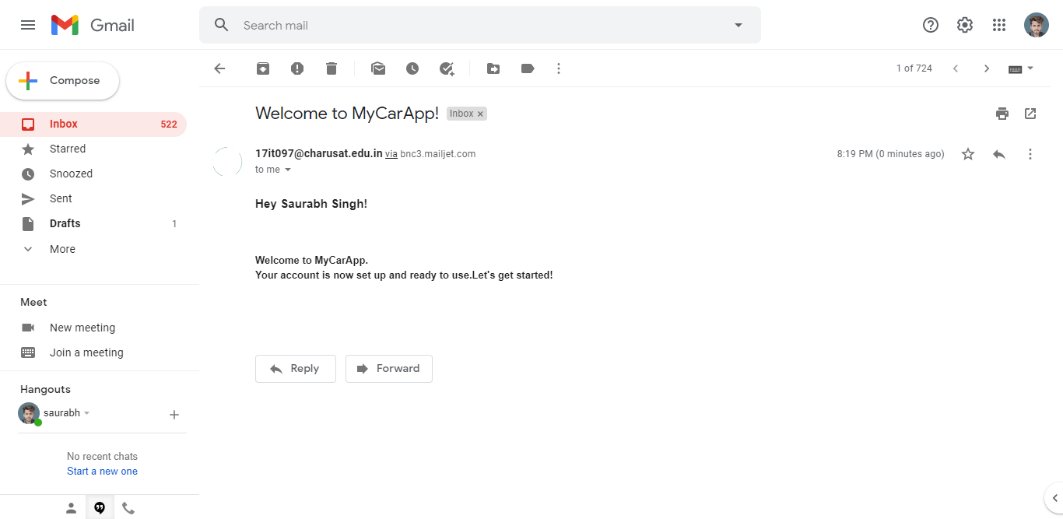
Email Integration on sign up

Slide 11
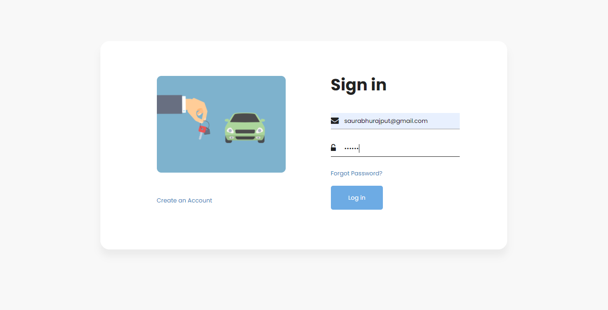
Sign in page

Slide 12
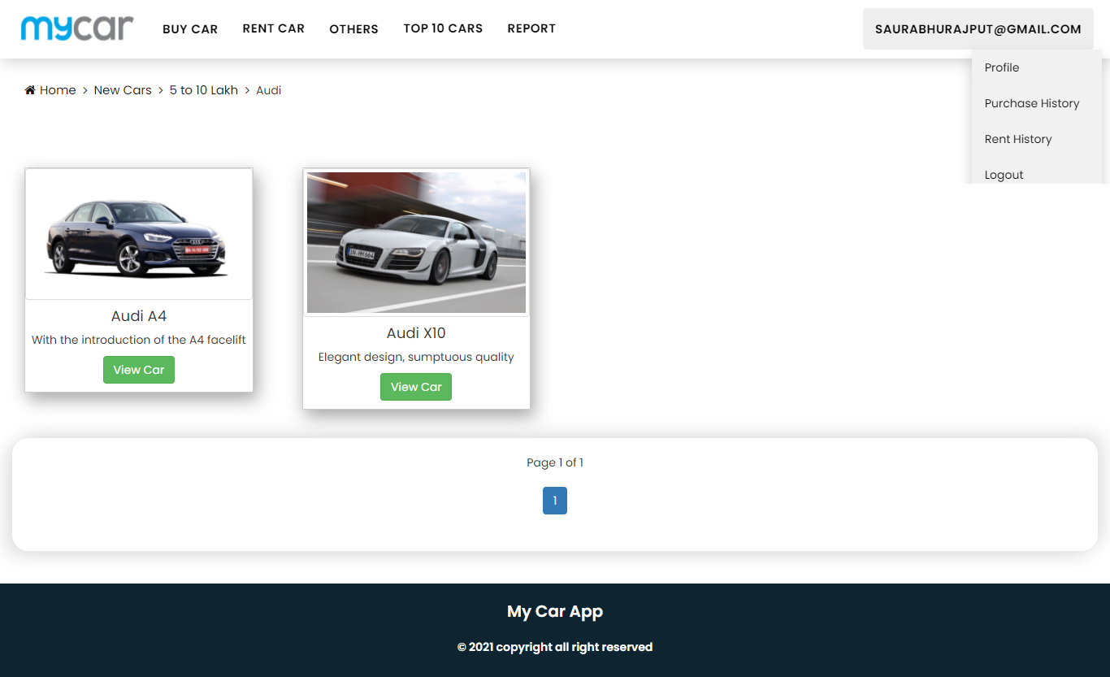
Custom Search Result

Slide 13
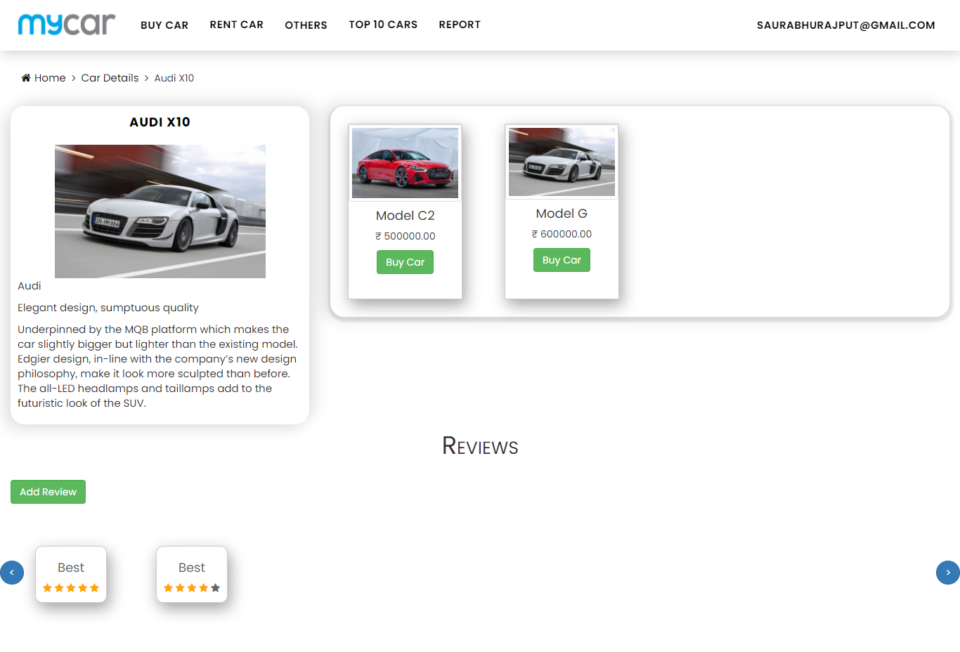
Car details and its variants with review system

Slide 14
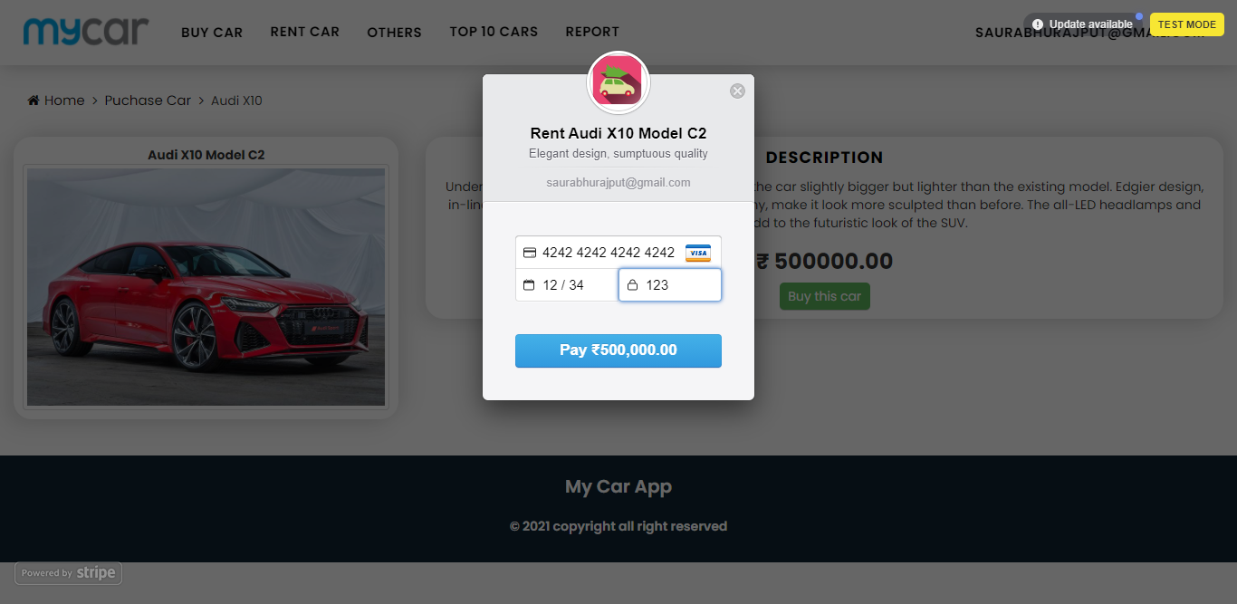
Purchase car with secure payment gateway

Slide 15
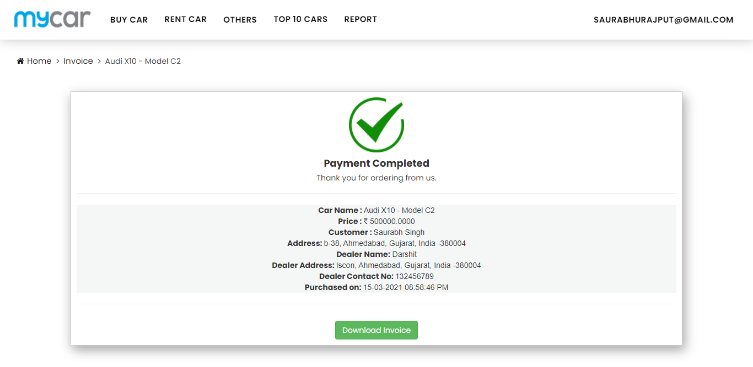
Payment confirmation page

Slide 16
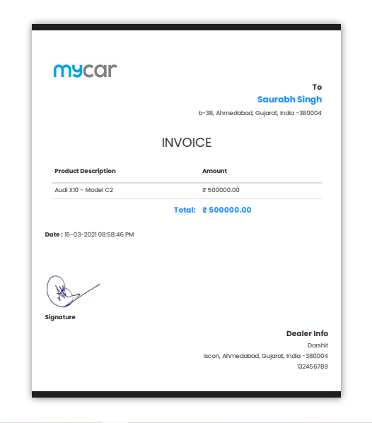
Invoice Generation

Slide 17
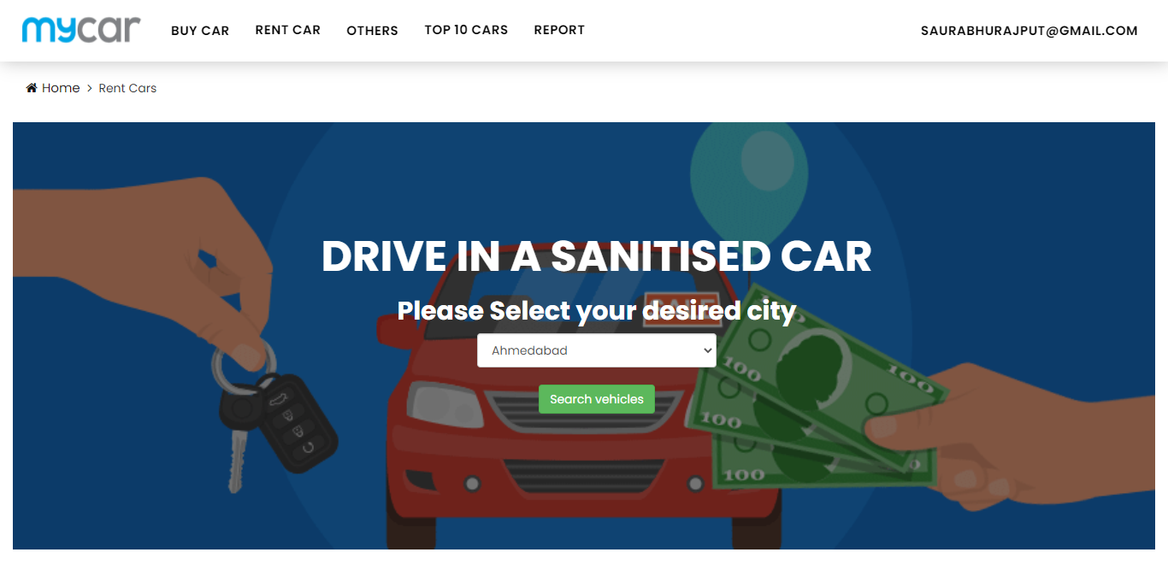
Rent cars by location

Slide 18
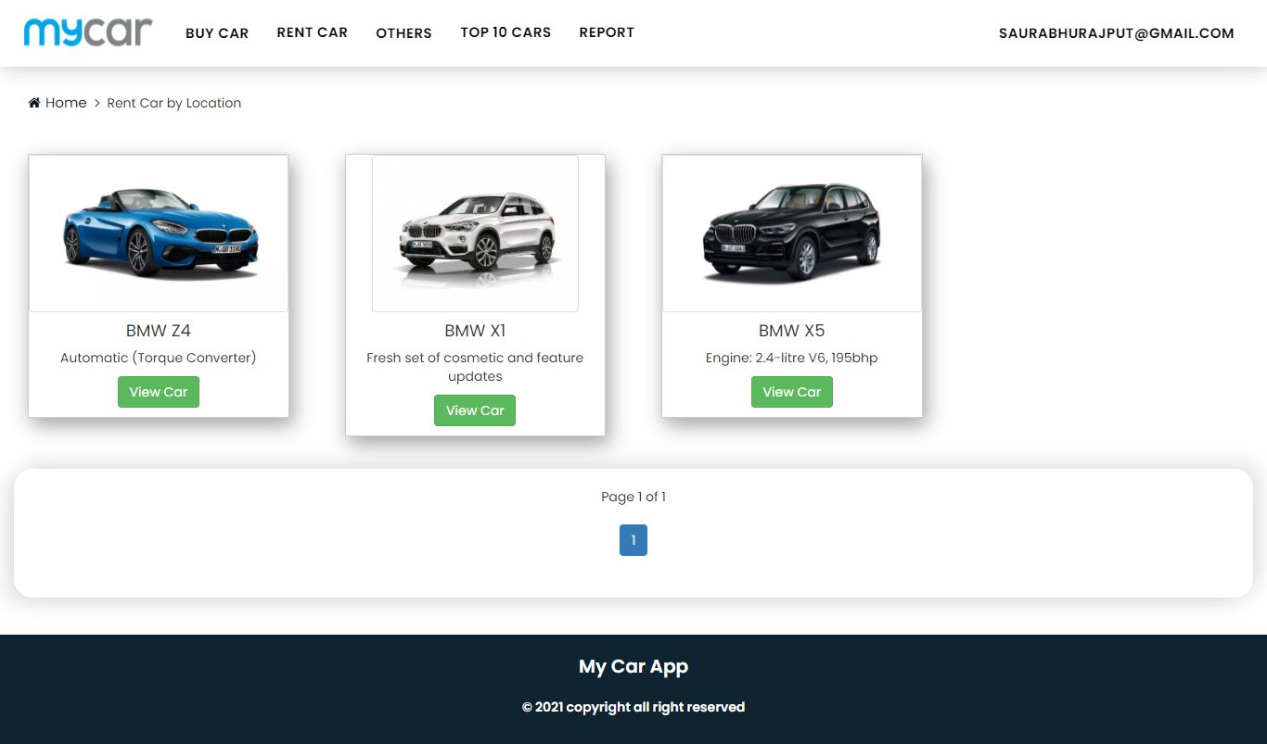
Location wise search for renting cars

Slide 19
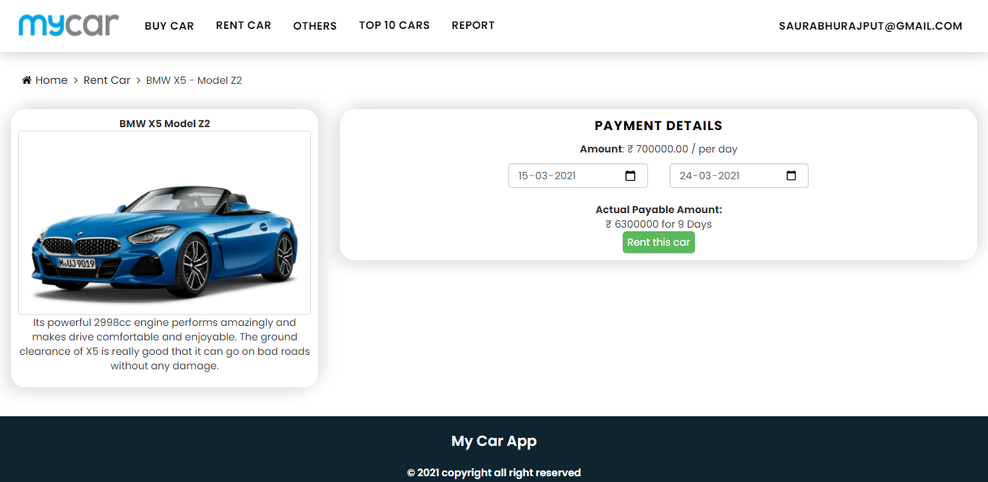
Rent Car Details

Slide 20
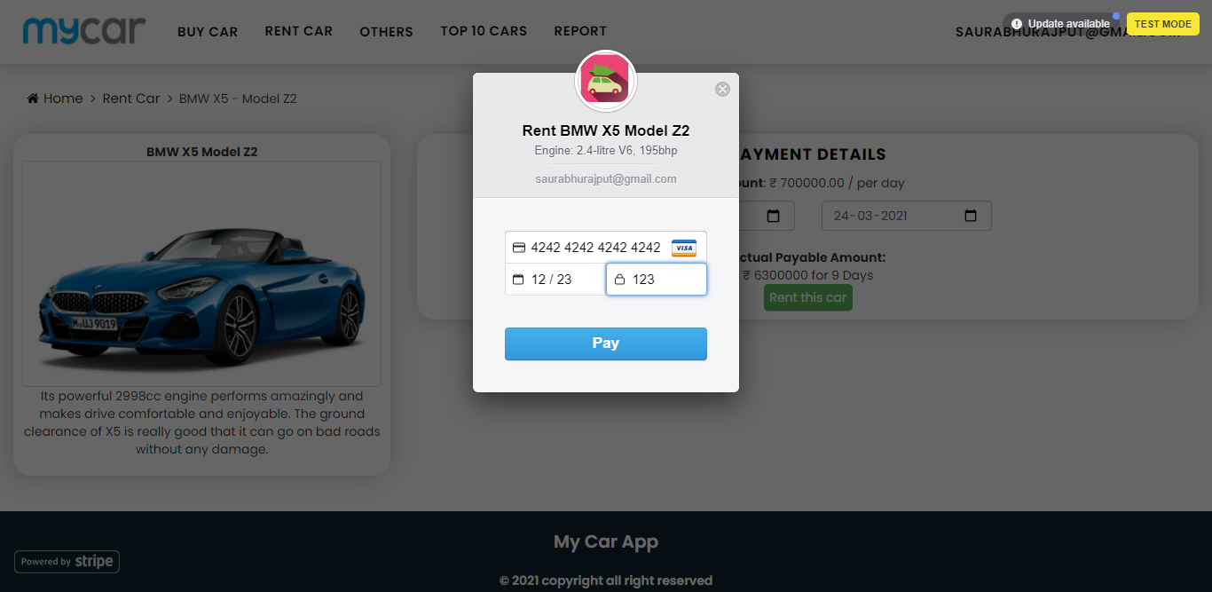
Rent a car with secure payment gateway

Slide 21
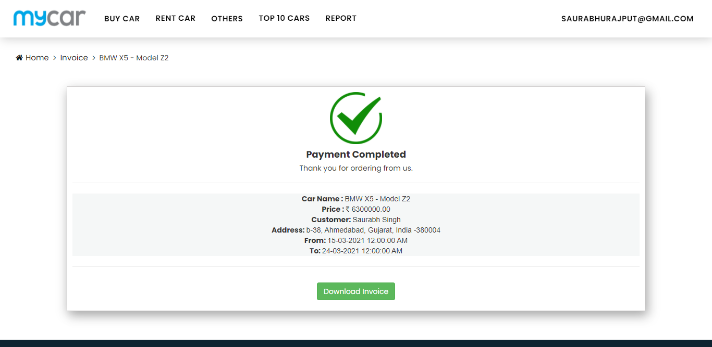
Renting payment confirmation page

Slide 22
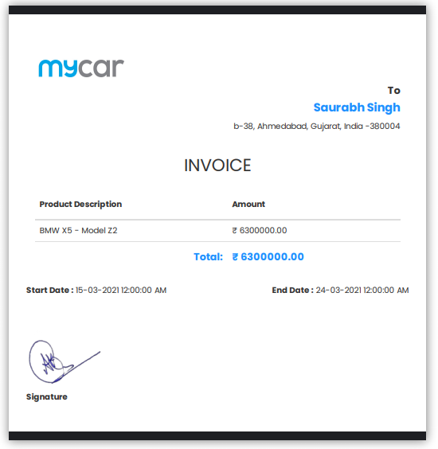
Invoice for car rent

Slide 23
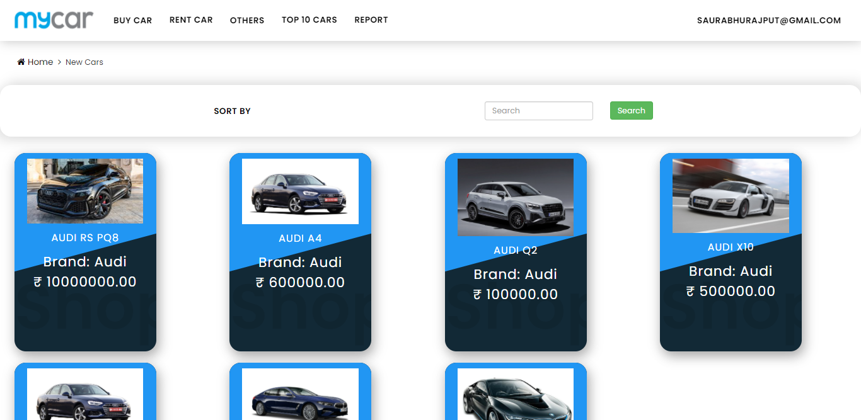
New and used cars screen

Slide 24
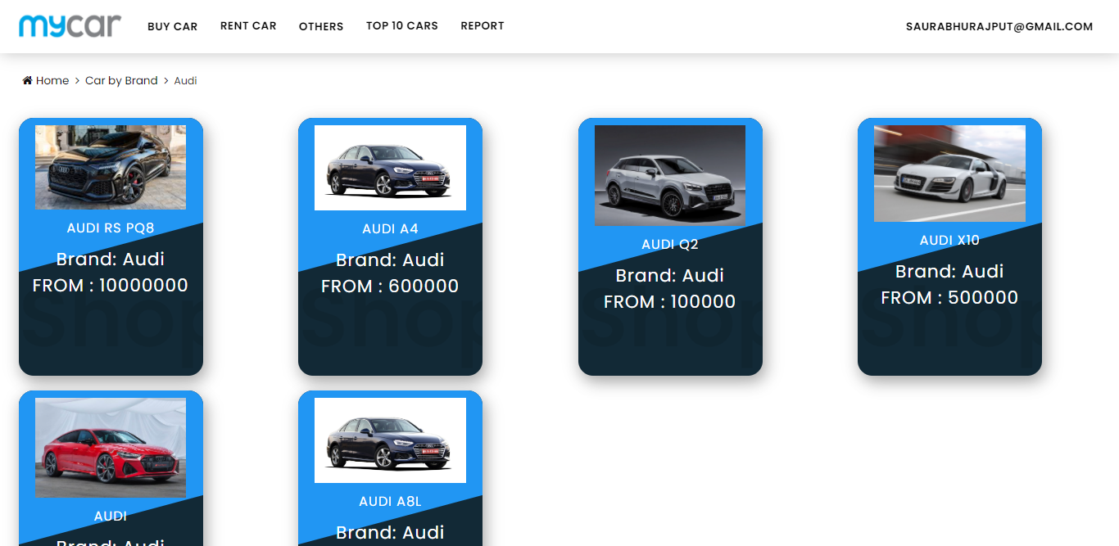
Cars by brands

Slide 25
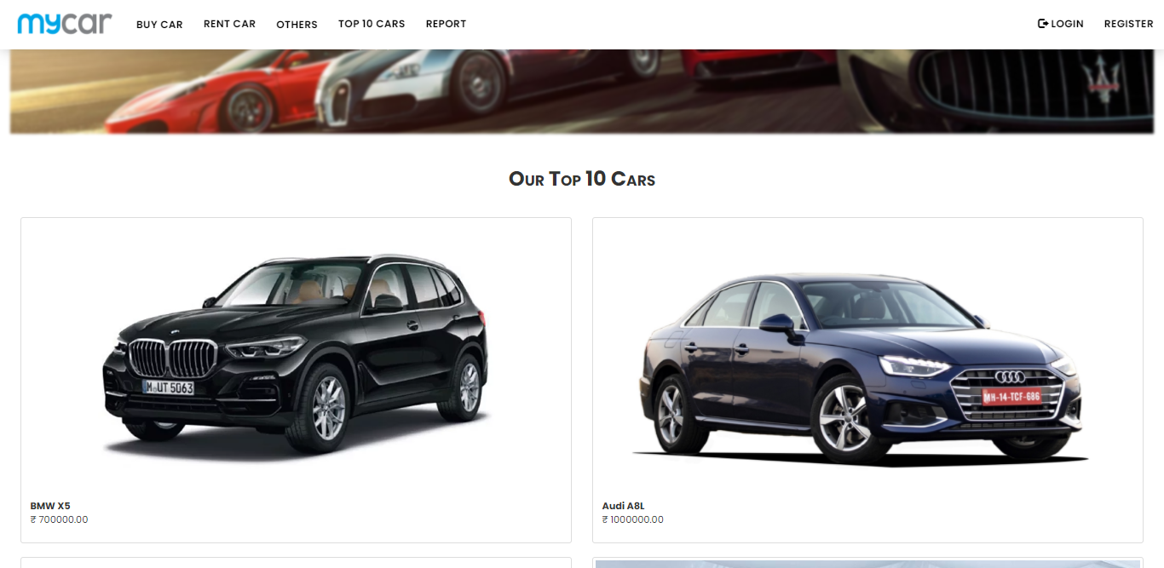
Top 10 Cars

Slide 26
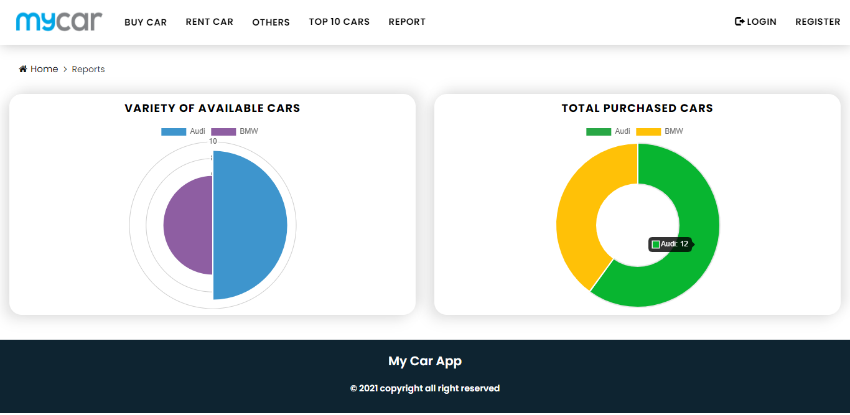
Reports visualization in charts

Slide 27
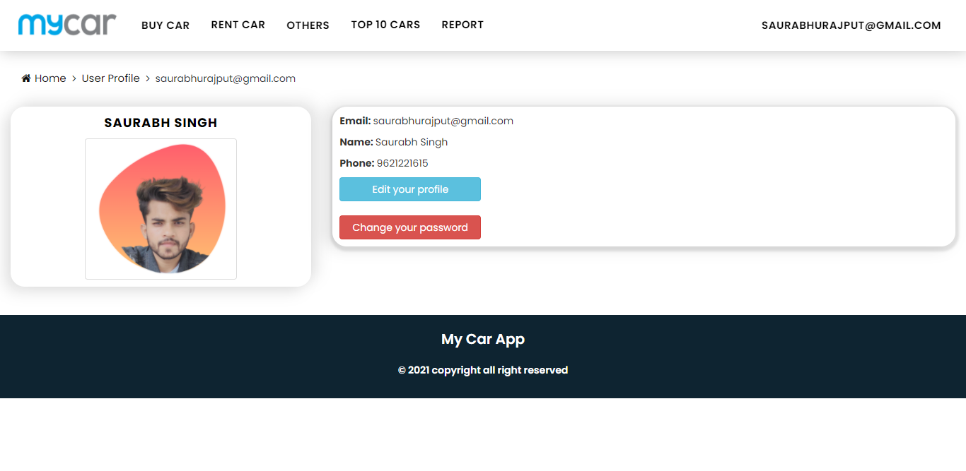
Profile Screen

Slide 28
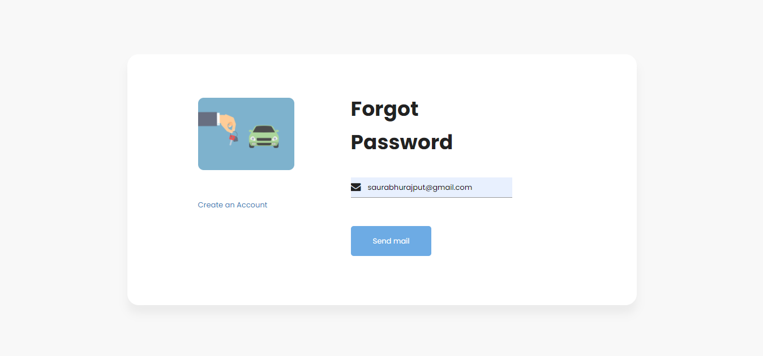
Forgot Password

Slide 29
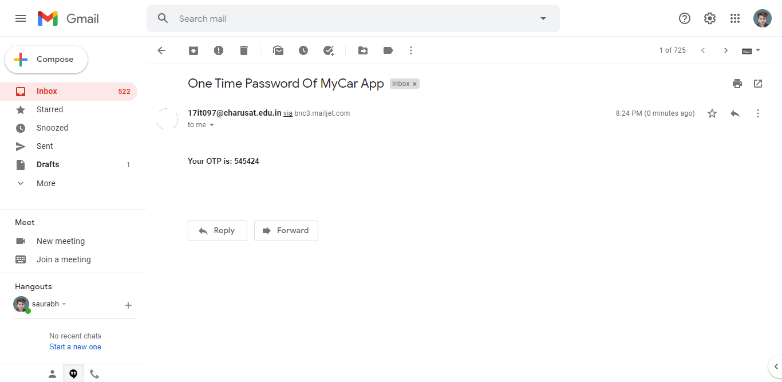
OTP Configuration

Slide 30
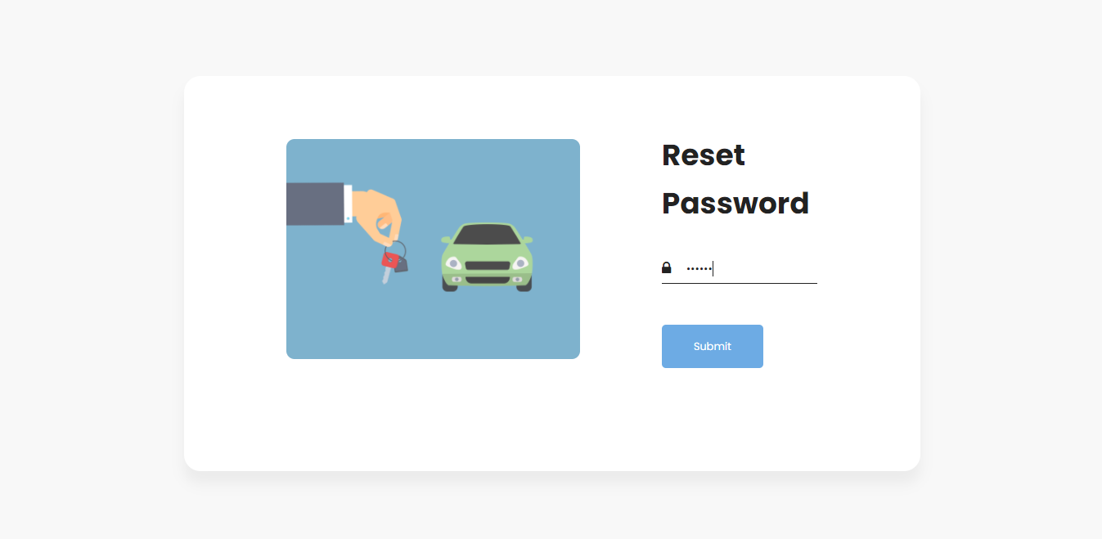
Reset password

Slide 31
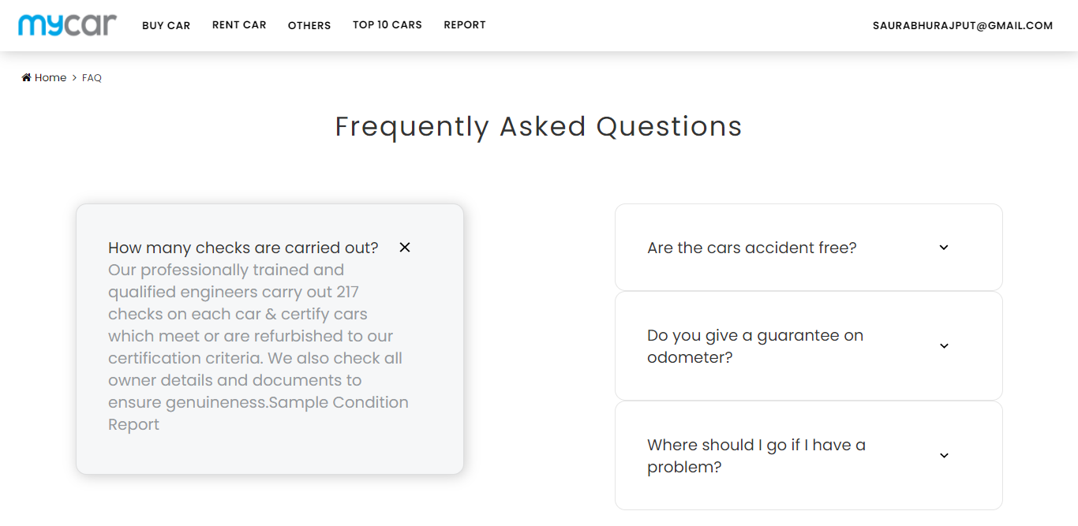
FAQ

Slide 32
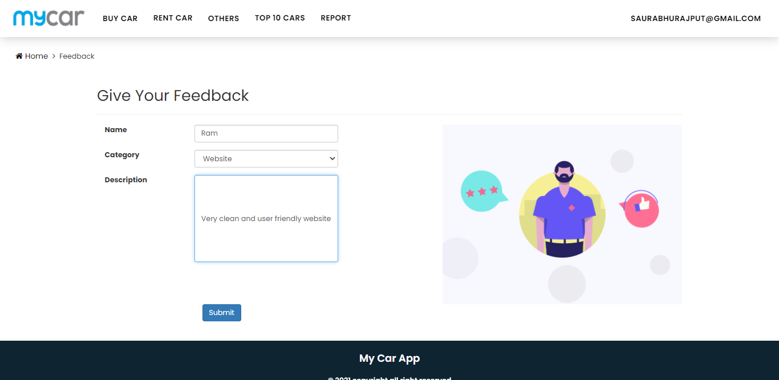
Feedback

Slide 33
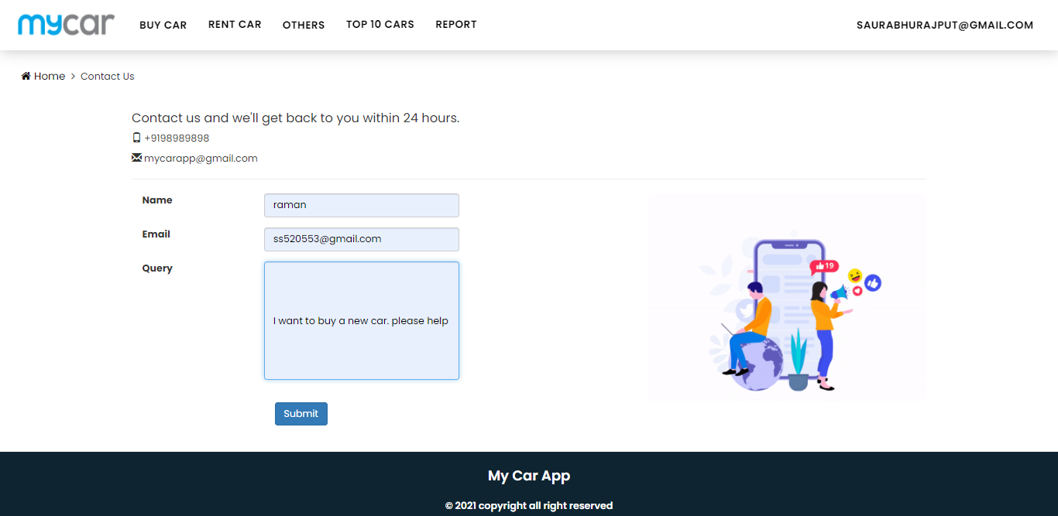
Contact us

Slide 34
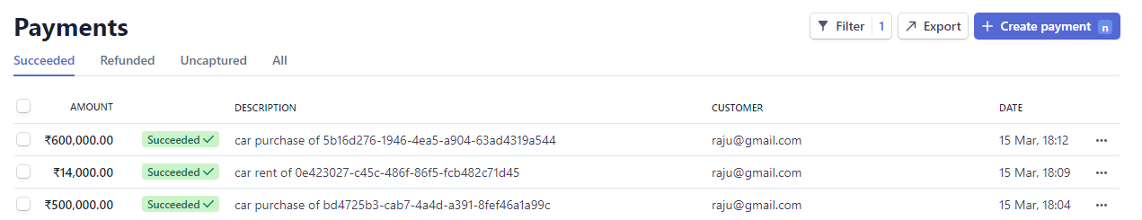
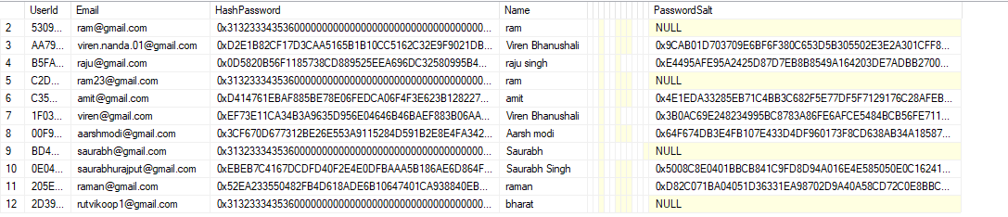
Stripe Payment Gateway Dashboard
Password hashing and salting for security

Slide 35
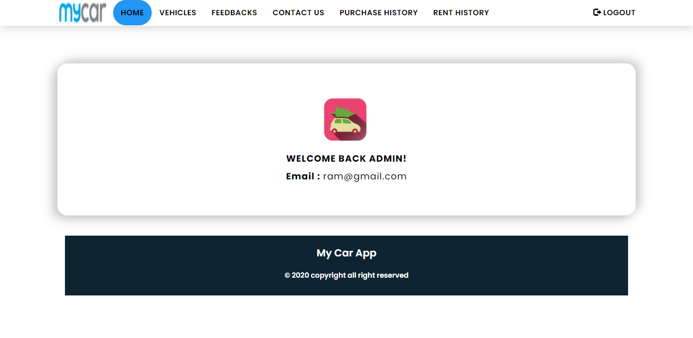
Admin Dashboard

Slide 36
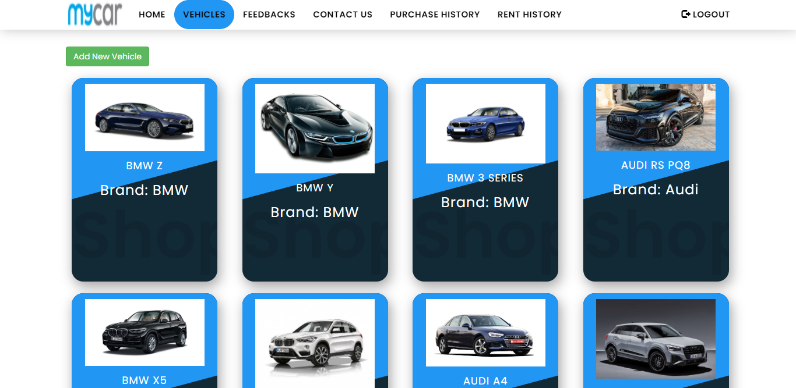
Admin Vehicle Listing

Slide 37
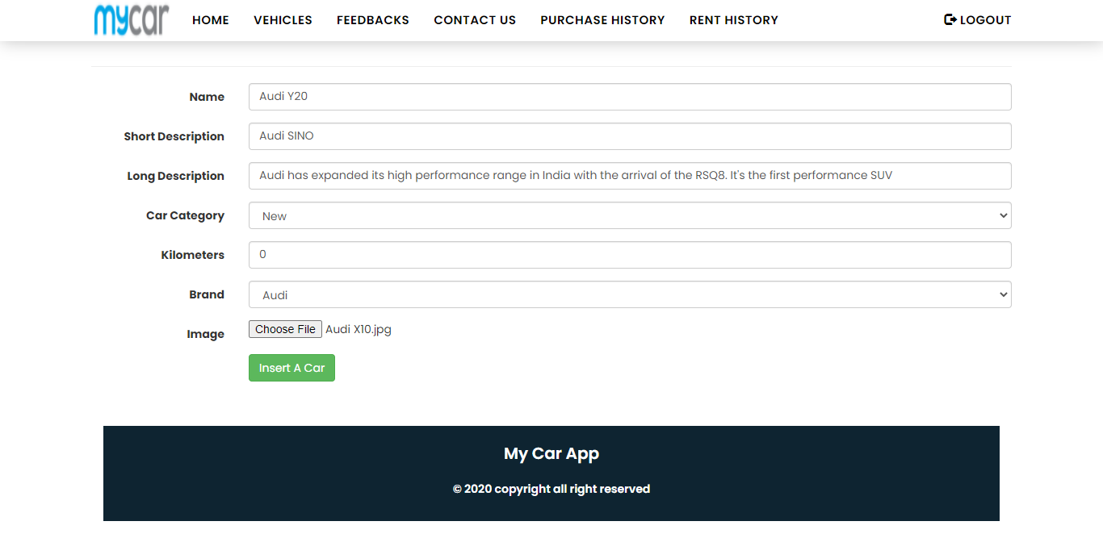
Add Vehicles from Admin back-panel

Slide 38
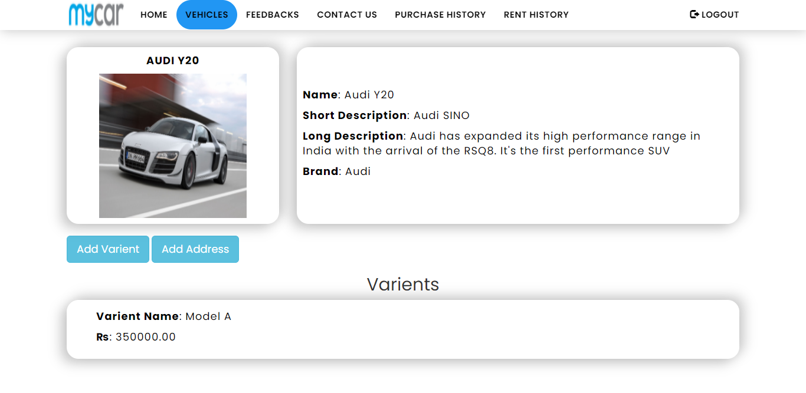
Car Details with its variants

Slide 39
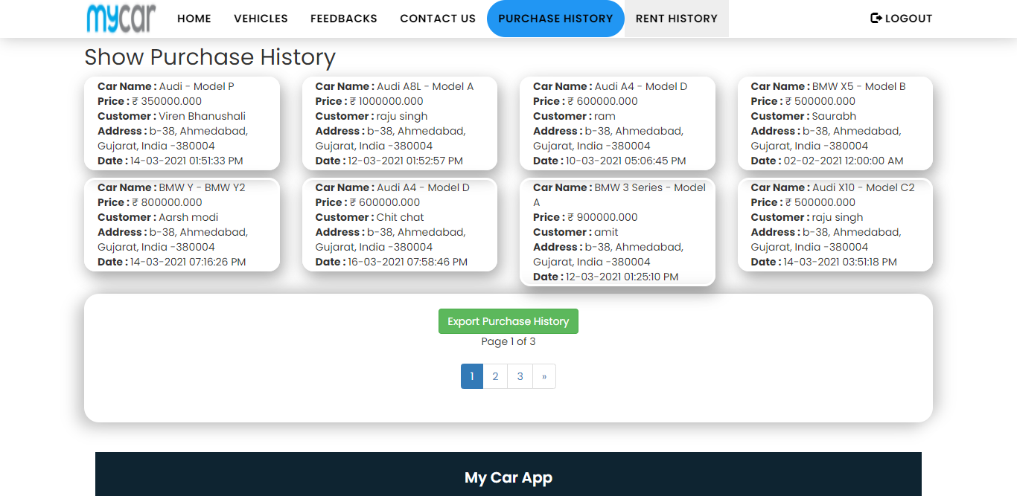
Admin Purchase History

Slide 40
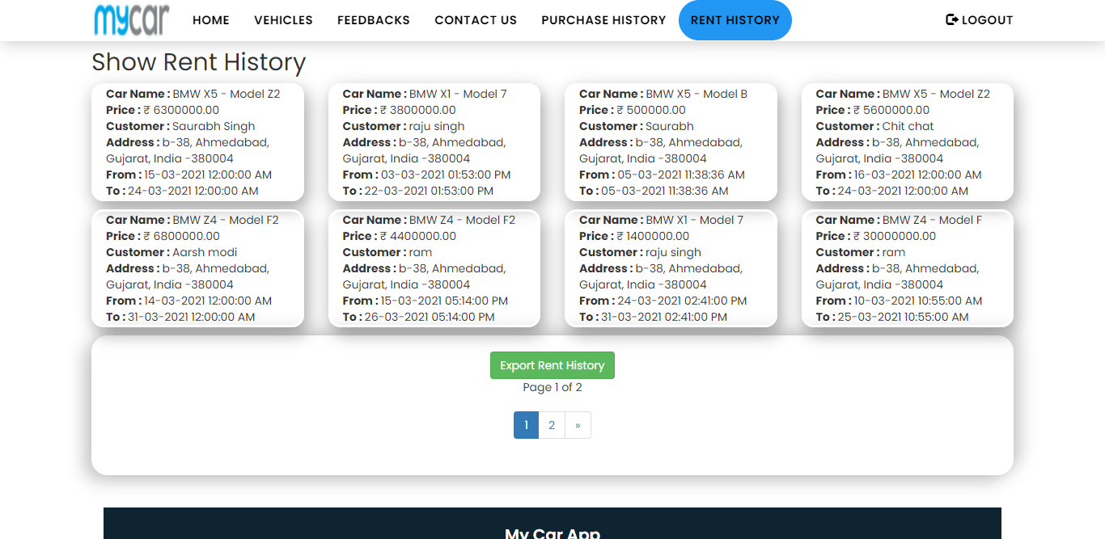
Admin Rent History

Slide 41
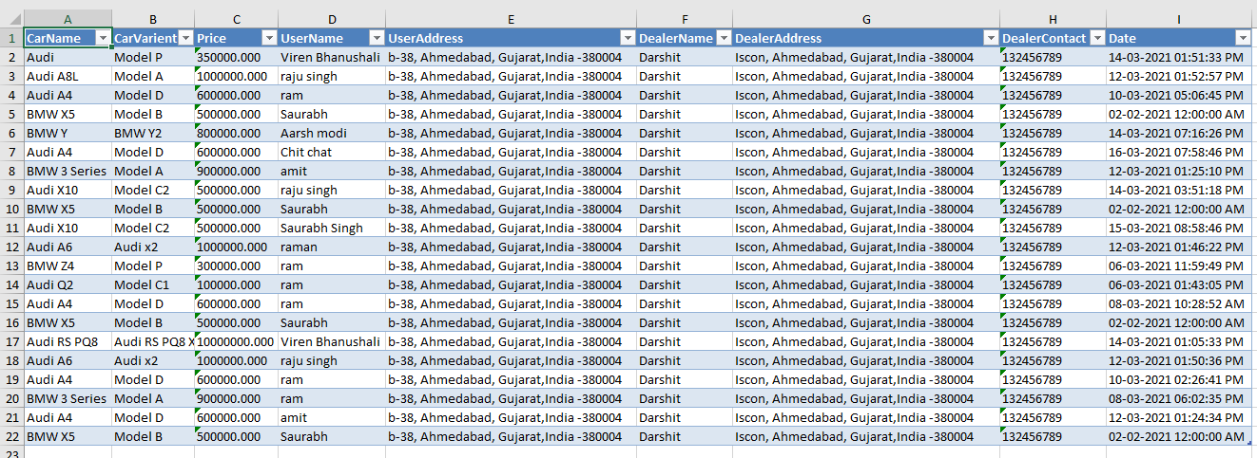
Order History Export to excel

Slide 42

Features
Introduction
This documentation covers Some important aspects of our Project. Project demonstrate Car purchasing and Car renting for user, User can create an account then buy/rent a car and can pay for their car online and can generate the invoice.
Conclusion
Flow Diagram
Data Dictionary

Slide 43

Anyone have query?

Slide 44


